Slide 1
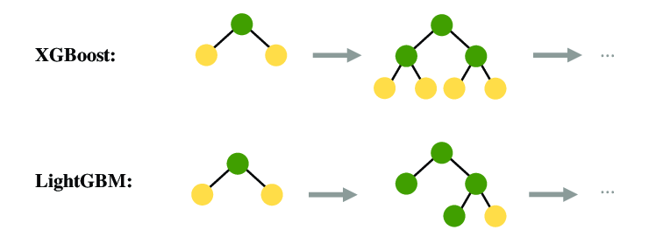
LightGBM Algorithm
Faster and more memory-efficient than XG Boost.
Using Histogram-based learning to speed up training
Using Leaf-wise tree growth instead of level-wise, making it more efficient.
Optimized for handling large datasets

Slide 2
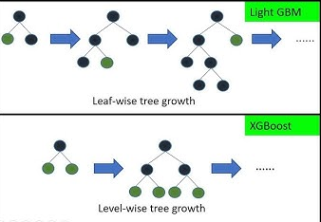
LightGBM Algorithm

Slide 3
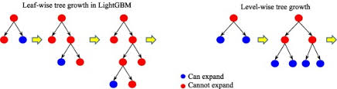
LightGBM Algorithm

